Slide 1
Quiz/Exam Management
System

Slide 2
Team Members
Siddharth (2100290140134)
Harsh (2100290140067)
Shivam Sharma (2100290140129)
Himanshu Pundir (2100290140070)
Project Supervisor
Mr. Ankit Verma

Slide 3
Introduction
The project Quiz/Exam Management System will be developed to overcome the time-consuming problem of manual system.
The whole examination process is automated, starting from preparing the question papers of various subject by the teachers till the calculations of results of students.
The aim of this project is to computerized the existing manual system and help to save valuable time and important data while conducting the quiz.
Apart from this, data which pre-exists in the system, will last for long period of time and will be easily accessible.

Slide 4
Objective
To create an appropriate platform for best managing of MCQ questions.
To overcome the time-consuming issues and taking MCQ quiz.
To release the marks of the quiz taker as soon as possible.
To manage the information of players.
To reduce paper work.

Slide 5
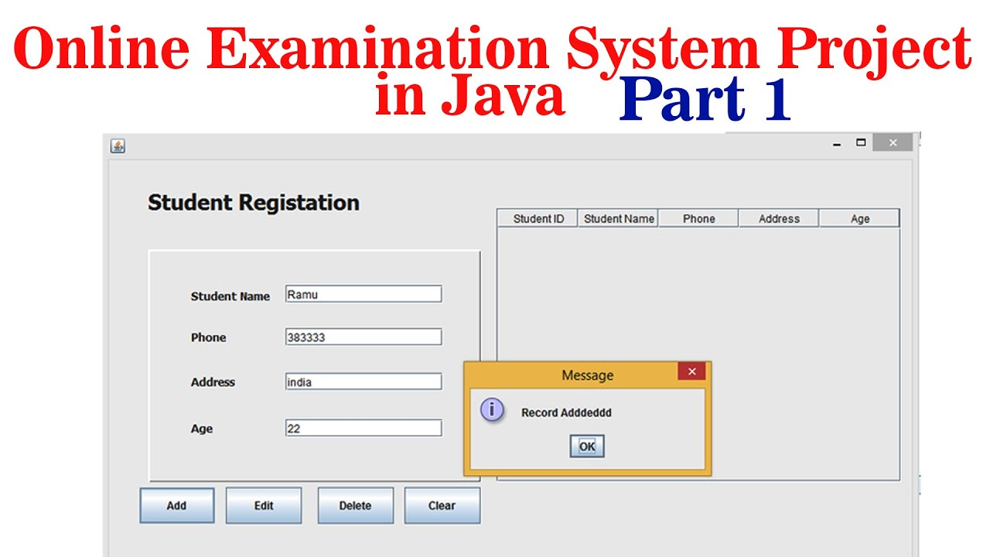
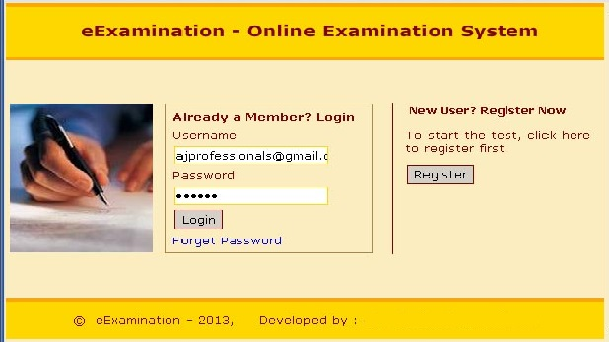
Example like:

Slide 6
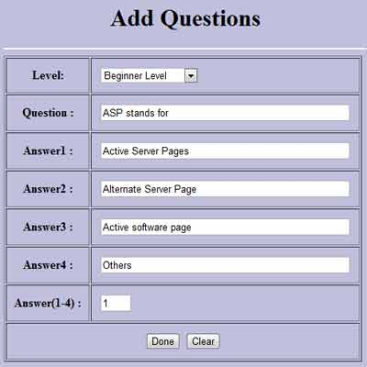
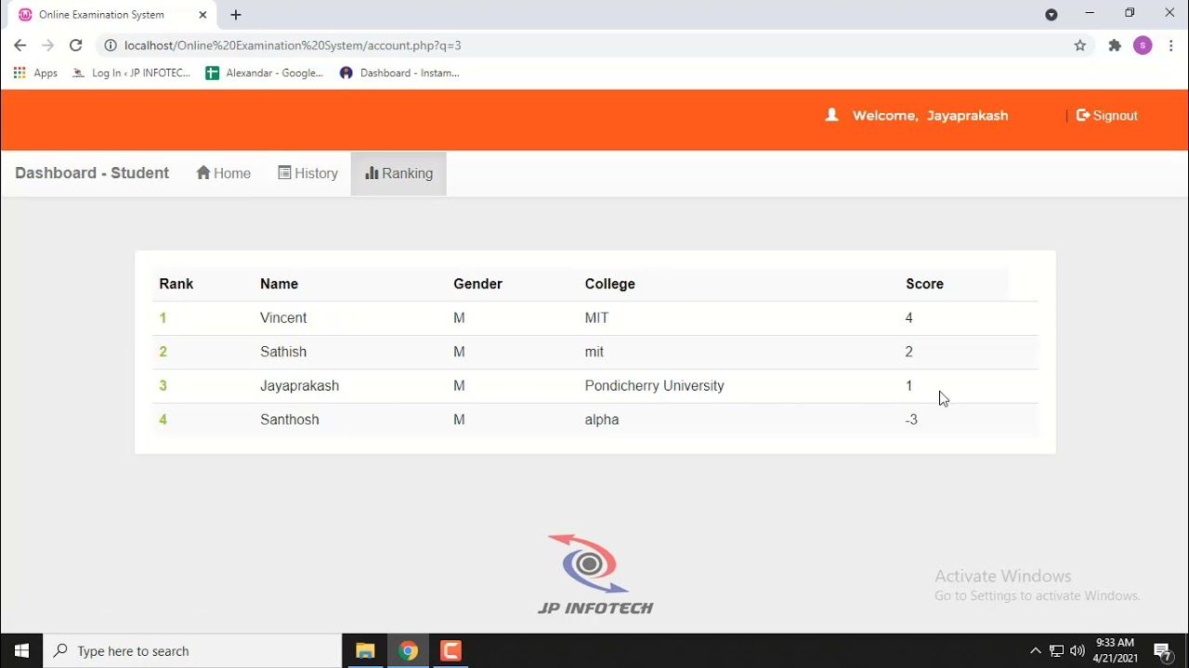

Slide 7
Hardware & Software Requirements Specification:
Hardware Requirements (Minimum): -
Processor: Intel Dual Core
RAM: 1GB
Hard Disk Drive: 120GB
Hardware Requirements (Recommended): -
Processor: Intel core i3
RAM: 4GB
Hard Disk Drive: 500GB

Slide 8
Software Requirements: -
Operating System: Windows XP and above, Linux
Front End tool:
JDK 1.8 and above
Back End tool:
MySQL
Editor:
NetBeans

Slide 9
Module Description
Registration:
Addition of new user
Modification of details of an existing user
Cancellation of registration of an existing user
Login:
It provides the facility to login into the System using their credentials.
This module may comprise of following two types of user:
A. Player
B. Admin

Slide 10
Subject Details:
It provides the facility to add and modify Subject Details for the quizzes.
Question Details:
In this module, we can modify the questions for the different subjects such as add new questions, update existing questions and remove questions.

Slide 11
Score Details:
This module provides the feature of storing, managing, reviewing the scores of different users.
Report:
This module can be used to generate the report for the performance of different users.

Slide 12
Conclusion
The Quiz Management System provides the facility to test a quiz test anytime. It saves time since the user doesn’t need to wait for results. Also performance can be measured quickly and easily.
Also administrators have privilege to add and modify as many questions as required in any subject.
The system provides an efficient environment to conduct quiz tests and can be easily used by Institutes for the same.

Slide 13
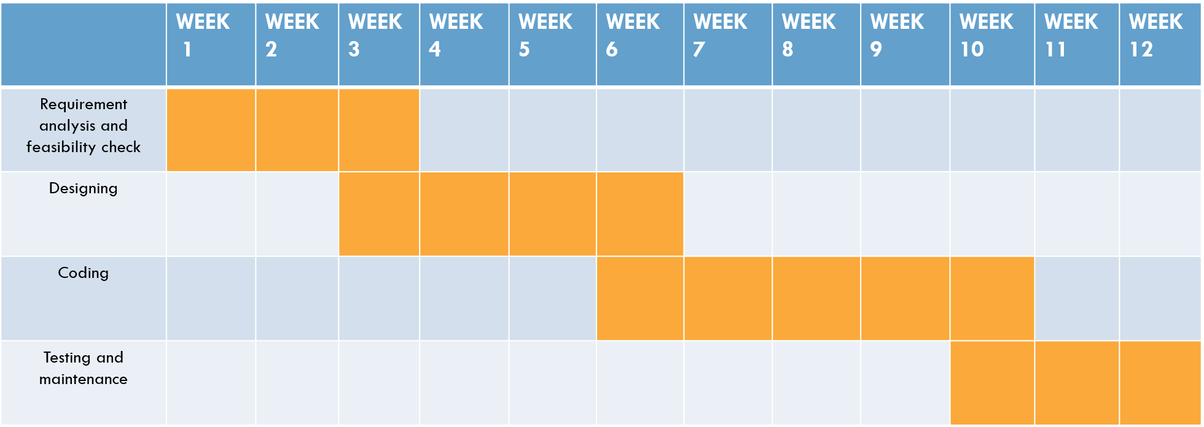
Gantt Chart

Slide 14
Thankyou

